Slide 1
Predicting Flight Prices
BY:
Manoj Kumar Saxena

Slide 2
Content
Problem Description
Data pre-processing
EDA
Data cleaning
Model Deployment
Hyper Parameter Tuning
Conclusion

Slide 3
Problem Description & Understanding of Data
Anyone who has booked a flight ticket knows how unexpectedly the prices vary. The cheapest available ticket on a given flight gets more and less expensive over time. This usually happens as an attempt to maximize revenue based on –
Time of purchase patterns (making sure last-minute purchases are expensive)
Keeping the flight as full as they want it (raising prices on a flight which is filling up in order to reduce sales and hold back inventory for those expensive last-minute expensive purchases).
So, we worked on this project where we collect data of flight fares with other features and work to make a model to predict fares of flights.
This project contains two phase:
Web Scrapping from websites
Model Building

Slide 4
Columns Description
AirlineName: The name of the airline.
Date: The date of the journey
Source: The source from which the service begins.
Destination: The destination where the service ends.
DepartureTime: The time when the journey starts from the source.
ArrivalTime: Time of arrival at the destination.
Duration: Total duration of the flight.
Total_Stops: Total stops between the source and destination.
Price: The price of the ticket

Slide 5
Data Summary
Data has no null values
Data has 1892 no. of records that we scrapped and 10 no. of variables.
Replaced non type Total Stops with 0
Chane dtypes for variables Total_Stops and price from object to integer and arrival time and departure time to time and Date of journey into date time.
Transformed New attributes like Duration in hours, Journey date, Departure hour, arrival hour

Slide 6
Exploratory Data Analysis (EDA)

Slide 7
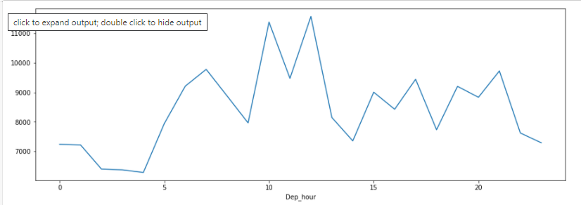
Morning flights are less expensive in comparison to others flights.

Slide 8
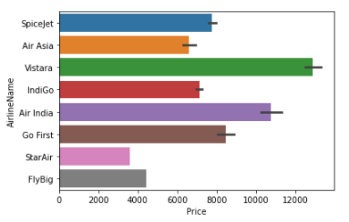
`Indigo` flights are less expensive in comparison to `SpiceJet`.
`Vistara` flights are most expensive.

Slide 9
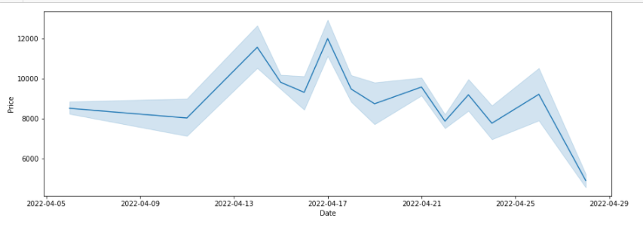
Flights fares are increasing as the departure date of the flights is getting closed. The fares increments over time is with some up and downs.

Slide 10
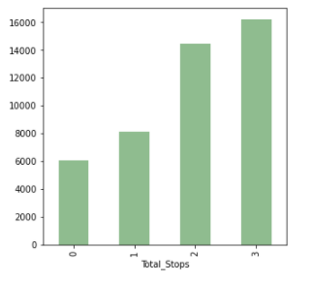
As No. of stops increments for the consumer to reach its destination with cost him expensive.

Slide 11
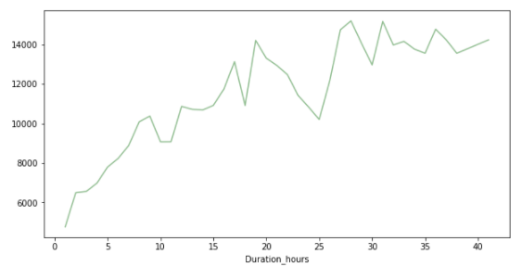
The Customer spends more time in flights cost him expensive to reach the destination.

Slide 12
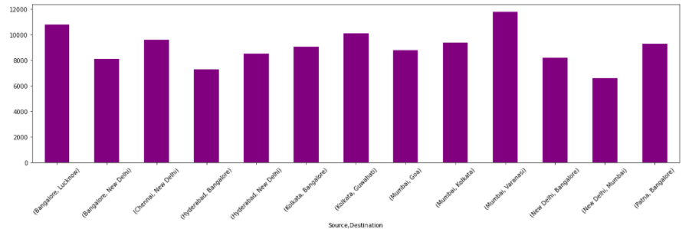
Mumbai To Varanasi flights are most Expensive.

Slide 13
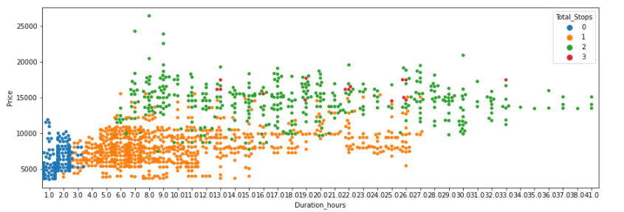
As the no of stops increasing slowly the price and duration increasing.

Slide 14
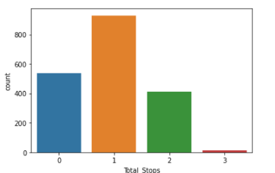
We have to remove records for 3 no. of stoppage because no much data we have for 3 Stoppage. That will made our model under fit.

Slide 15
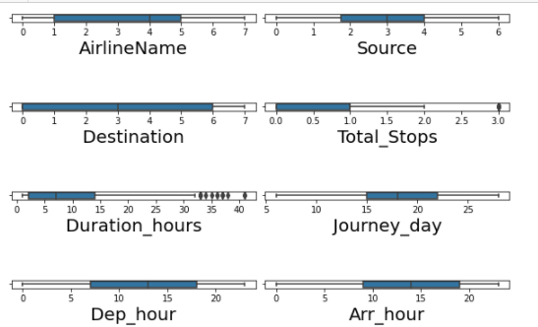
Outliers Detection:
Clearly we can see Outliers in two attributes:
Totals_Stops
Duration_hours

Slide 16
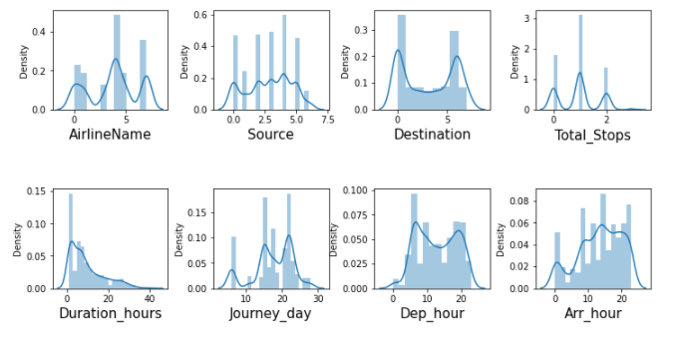
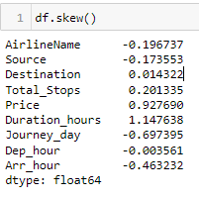
Distribution Plot
Clearly seen from graph and given skewness that are skewed:
Journey_day
Duration_hours

Slide 17
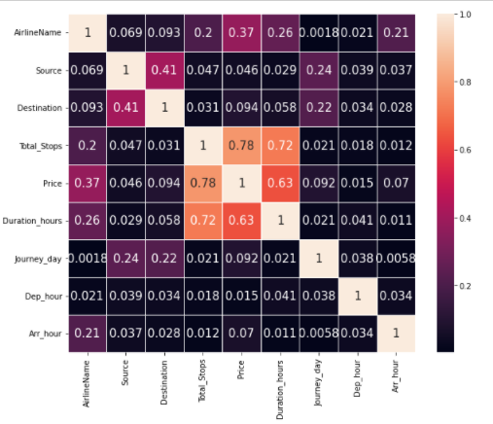
Co-relation of inputs
NO Multi- collinearity exists.

Slide 18
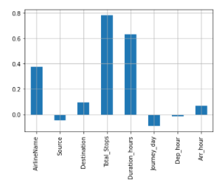
Relation of features and label
Total-stops and Duration hours are mostly corelated to the Price.

Slide 19
Conditions that are considered for Data Cleaning & Transformed activities
Dropped attributes from which we transformed new attributes.
Transformed categorical attribute using label Encoder techniques.
Used Boxplot for Outliers detection and removed with Z- score technique.
Used Distplot for Distribution and removed with Power Transformer with box-cox method.

Slide 20
Model Deployment

Slide 21
Algorithms Used:
Used 5 models that are:
Linear Regression
Decision Tree
Random Forest
AdaBoost
Bagging
K Nearest Neaighbours

Slide 22
Before training or test the dataset steps we perform
Splits the data into features and Labels
Standardized the features

Slide 23
Accuracy of each model
The highest accuracy is 73.4% of model Linear Regression at random state 157.
The highest accuracy is 91.8% of model Decision Tree at random state 175.
The highest accuracy is 95.4% of model Random Forest at random state 178.
The highest accuracy is 94.2% of model Bagging at random state 178.
The highest accuracy is 81.3% of model AdaBoost at random state 157.
The highest accuracy is 87.3% of model KNN at random state 175.

Slide 24
Best CV Score of each model
Mean CV Score of model Linear Regression:: 56.5
Mean CV Score of model Decision Tree :: 66.3
Mean CV Score of model Random Forest :: 77.25
Mean CV Score of model AdaBoost :: 59.2
Mean CV Score of model Bagging :: 75.2
Mean CV Score of model KNN :: 62.9

Slide 25
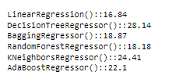
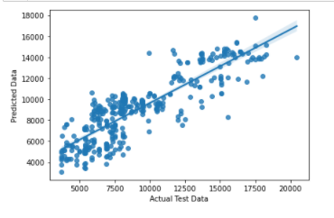
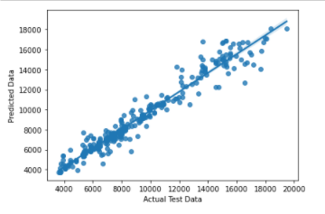
Finalized Model Selection
Least Difference between CV Score And R2 score
Regplot For Linear Model
RegPlot for Random Forest
Here we finalized Random Forest Model because the least difference between V Score And R2 score is for Linear but the regplot for Random Forest Showing Good Results.
So, We used Random Forest as finalized model.

Slide 26
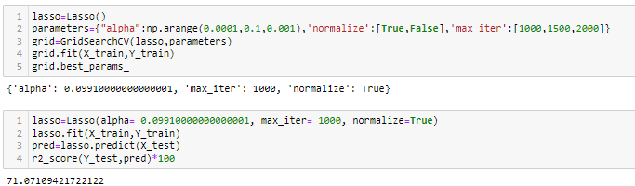
Regularization
Used Lasso Model Got 71.07

Slide 27
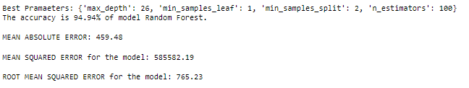
Hyper Parameter tuning
Showing Best parameter For random Forest and got metrics Like
Mean Absolute Error
Mean Squared Error
Root Mean squared error

Slide 28
THANK YOU!!

